Slide 1

DEEP NEURAL NETWORK MODULE # 3 : LINEAR NEURAL NETWORKS FOR REGRESSION
DNN Team
BITS Pilani WILP

Slide 2
The instructor is gratefully acknowledging the authors who made their course materials freely available online.
This deck is prepared by Seetha Parameswaran.
Deep Learning

Slide 3








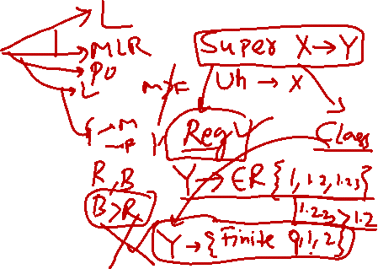
Table of Contents
Regression
Linear Regression
The Linear Model: Single Neuron
Worked Example
Evaluation
Python Implementation Implementation Tips
Summary
1
2
3
4
5
6
7
8
Deep Learning

Slide 4
What is Regression?
Definition
Regression is a supervised learning task that predicts a continuous-valued output based on input features.
Key Characteristics:
Input: Feature vector x ∈ R^{d}
Output: Real-valued target y ∈ R
Goal: Learn a function f : R^{d} → R such that y ≈ f (x)
Deep Learning

Slide 5
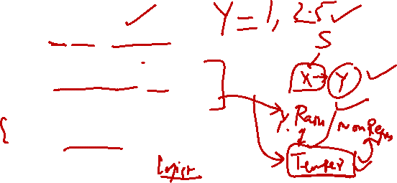
Examples of Regression Problems
House Price Prediction
Input: Size, location, number of rooms
Output: Price in dollars
Temperature Forecasting
Input: Historical weather data, season, humidity
Output: Temperature in degrees
Stock Price Prediction
Input: Historical prices, trading volume, market indicators
Output: Future stock price
1
2
3
Deep Learning

Slide 6


Table of Contents
Regression
Linear Regression
The Linear Model: Single Neuron
Worked Example
Evaluation
Python Implementation Implementation Tips
Summary
1
2
3
4
5
6
7
8
Deep Learning

Slide 7
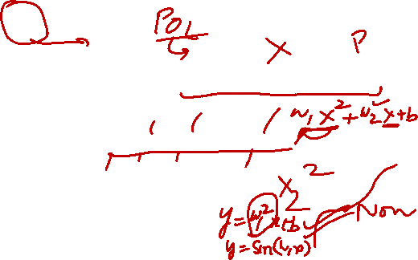
What is Linear Regression?
Definition
Linear regression assumes the output is a linear combination of the input features.
Mathematical Form:
y = w₀ + w₁x₁ + w₂x₂ + · · · + w_{d}x_{d}
(1)
where:
x = [x₁, x₂, . . . , x_{d} ]^{T} are the input features
w = [w₁, w₂, . . . , w_{d} ]^{T} are the weights
w₀ is the bias term
Deep Learning

Slide 8
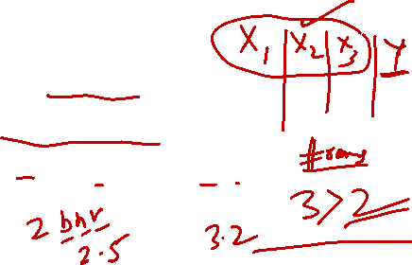
Examples of Linear Regression
1
Salary Prediction
Salary = w₀ + w₁ × Years of Experience
2
Crop Yield Prediction
Yield = w₀ + w₁ × Rainfall + w₂ × Fertilizer
3
Energy Consumption
Energy = w₀ + w₁ × Temperature + w₂ × Hour + w₃ × Day
The relationship between inputs and output is assumed to be linear.
Deep Learning

